Slide 1
SITE SUITABILITY ANALYSIS FOR HEALTH CENTRES
Using ArcGIS Pro ModelBuilder
OTHAYA –NYERI -KENYA

Slide 2
Introduction
Othaya, Nyeri is a rural sub-county in central Kenya, with scattered settlements and limited health infrastructure.
Healthcare accessibility is vital for reducing mortality, especially in remote areas where distance delays treatment.
Site suitability analysis uses GIS to identify optimal locations for new health centers, ensuring efficient service delivery and equitable access.

Slide 3
Objectives
Identify suitable locations for new health centers
Use GIS spatial analysis to support health infrastructure planning
Automate analysis with ModelBuilder in ArcGIS Pro

Slide 4
Study Area
Map of Nyeri County showing Othaya Sub-county
Key facts: population(VILLAGES), terrain(SLOPE), infrastructure
(EXISING HC).
Add a location map inset (Kenya → Nyeri → Othaya)

Slide 5
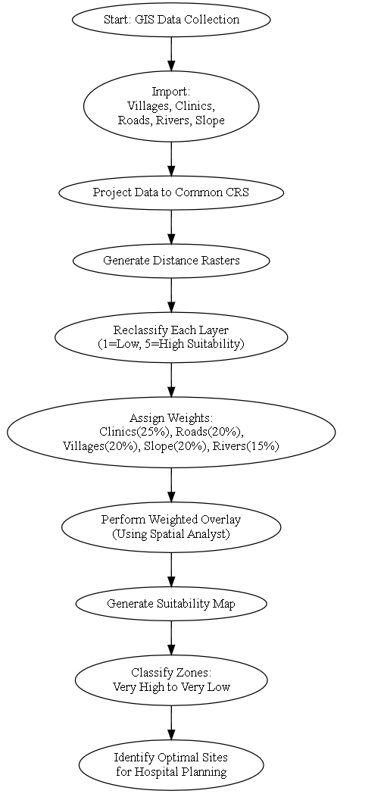
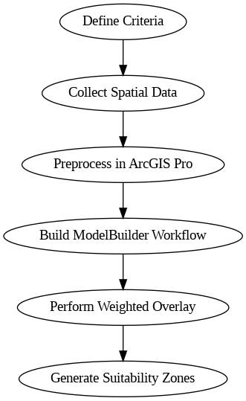
Methodology
Define Criteria Identify key factors influencing health center location (e.g., population, slope, accessibility)
Collect Spatial Data Gather layers: roads, population, DEM, existing health facilities
Preprocess in ArcGIS Pro Clip, reclassify, buffer, and project datasets
Build ModelBuilder Workflow Automate the analysis steps using ModelBuilder tools
Perform Weighted Overlay Apply weights to criteria to compute a composite suitability map
Generate Suitability Zones Classify output into zones: very suitable, suitable, moderate, unsuitable

Slide 6
Criteria and Datasets
Key Criteria Used:
Population density
Road accessibility
Water accessibility
Terrain slope
Distance to existing health facilities
Datasets Collected:
Digital Elevation Model (DEM)
Road network shapefiles
Villages data
Rivers
Health facility locations(existing)

Slide 7
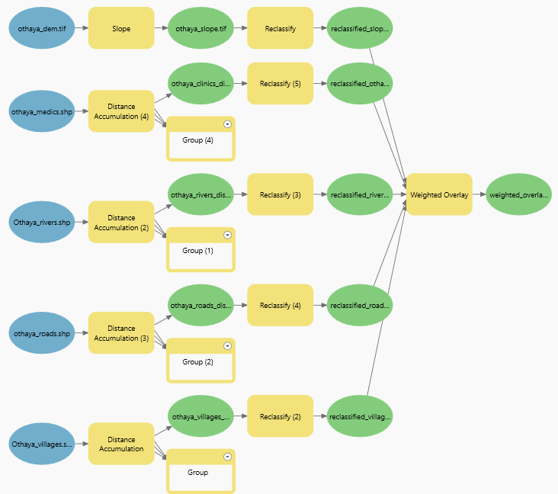
ArcGIS Pro ModelBuilder
Input Layers (Blue Ovals)
othaya_dem.tif – A Digital Elevation Model.
othaya_medics.shp – Locations of medical facilities.
Othaya_rivers.shp – Rivers in the region.
othaya_roads.shp – Road networks.
Othaya_villages.shp – Village locations.
Processing Steps (Yellow Rectangles)
Slope Calculation from DEM.
Distance Accumulation from features like rivers, roads, medics, and villages.
Reclassification of raster outputs to common suitability scales.
Weighted Overlay combines all reclassified rasters.
weighted_overlay – The final suitability map showing areas ranked based on weighted influence from all factors.

Slide 8
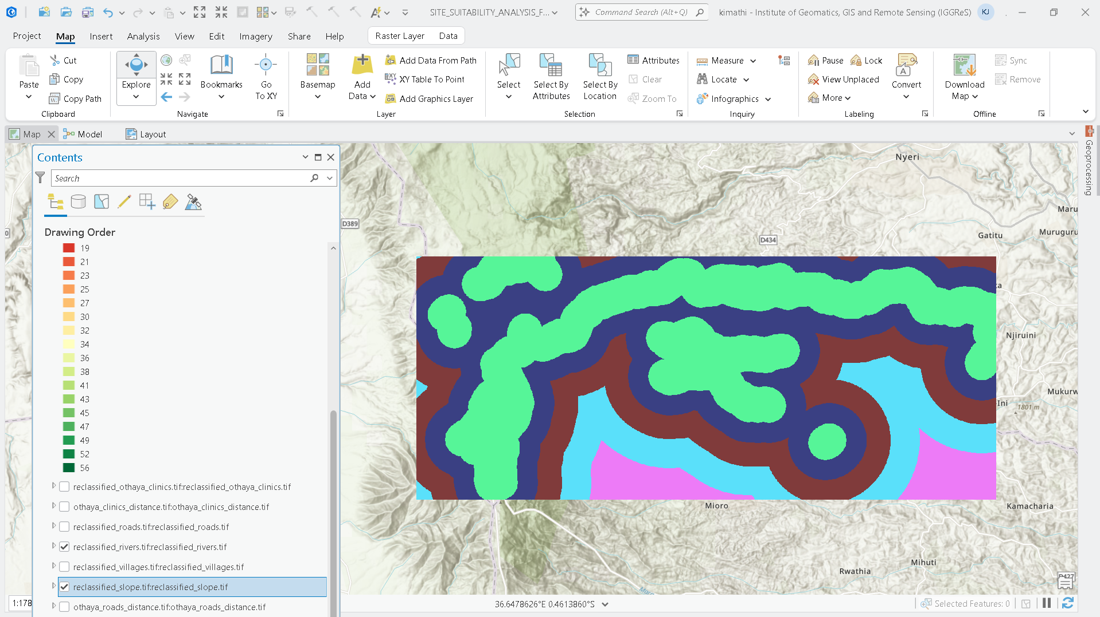
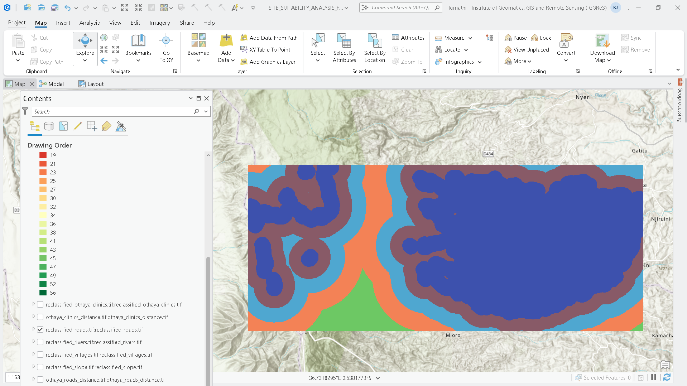
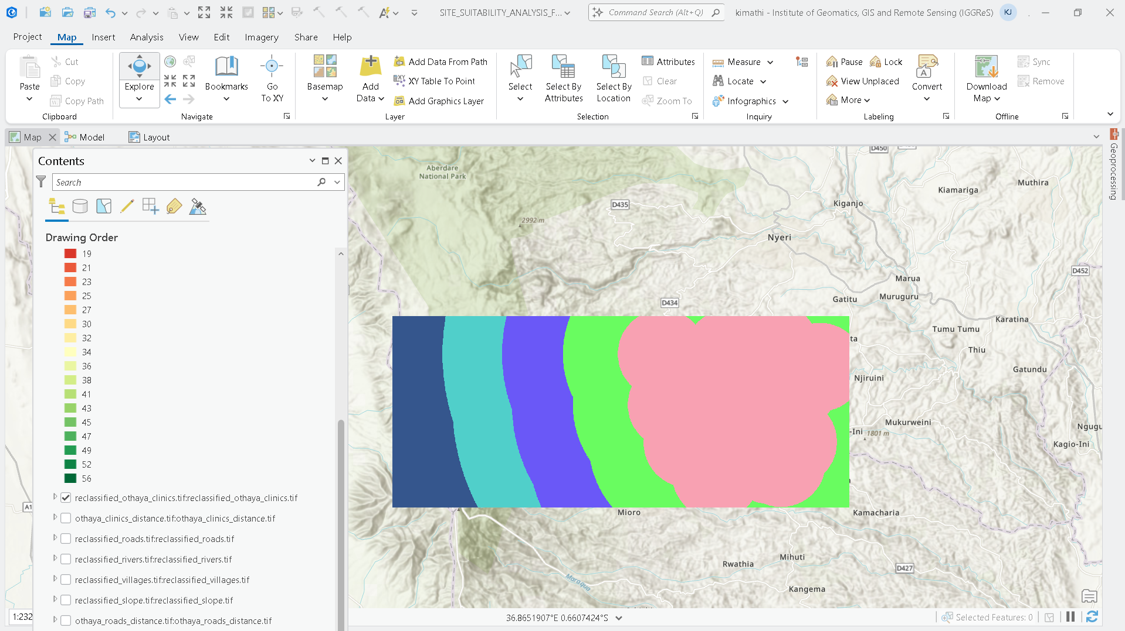
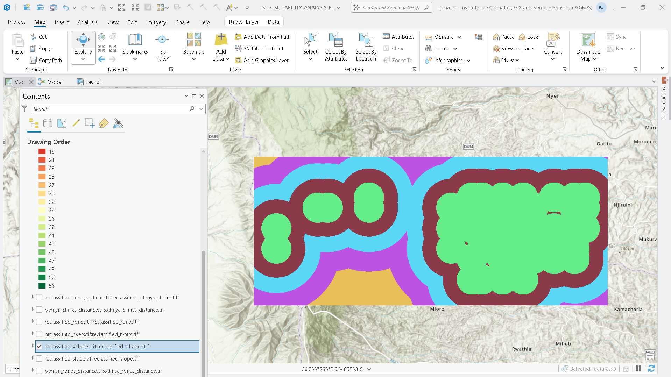
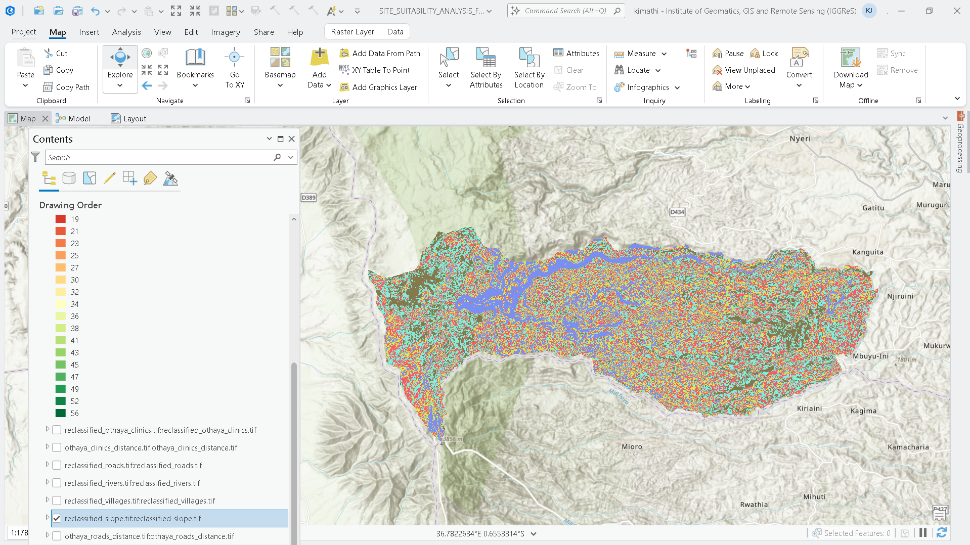
Suitability Analysis
Very Suitable
Suitable
Moderate
Unsuitable zones

Slide 9
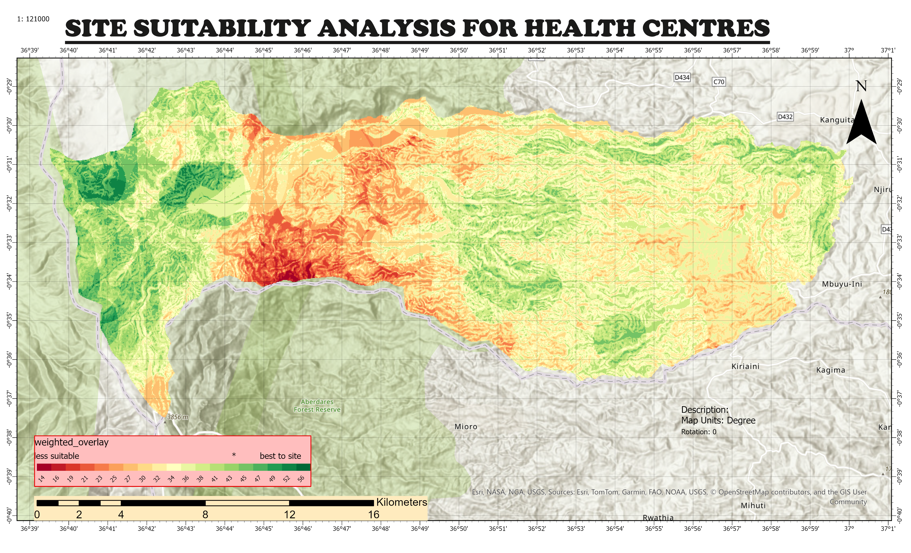
Final Suitability Map

Slide 11
VALIDATION
Validation Steps:
✅ Overlay suitable zones with:
High-density underserved population clusters.
Areas with limited access to existing facilities.
Areas with water and road network.
Areas with gentle slope.

Slide 12
Recommendations
Establish new health centers in zones identified as highly suitable through weighted overlay analysis.
Prioritize areas with:
Good road access
Good water access
Gentle sloppy
Close to population(village)
Away from existing health centers.

Slide 13
Challenges
Data Limitations
Outdated or incomplete health facility/villages records
Technical Constraints
Low-resolution DEM affects slope and elevation accuracy
Buffer and distance tools may introduce spatial inaccuracies
Model Limitations
Uses static population data — may not reflect current trends
Doesn’t account for seasonal or temporary shifts

Slide 14
Conclusion
GIS & ModelBuilder enable evidence-based planning for sustainable health service delivery.
Suitability analysis offers a powerful, visual tool to guide strategic decision-making.
Future Enhancements:
Integrate real-time or dynamic population data
Use mobile-based field validation and crowdsourced inputs/Community participation.
Automate regular updates for adaptive planning

Slide 15
References
Kenya data
OpenTopography DEM DOWNLOADER PLUGIN
ArcGIS Pro Documentation
Health Facilities in OTHAYA Constituency WEB

Slide 16
THANK YOU
PRESENTED BY GIS GROUP

